Slide 1
Chapter 6 COLOR IMAGE PROCESSING
For a long time I limited myself to one color-as a form of discipline.
Pablo Picasso

Slide 2
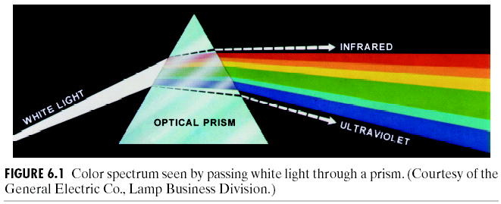
Color Fundamentals
As shown in Fig. 6.1,the color spectrum may be divided into six broad regions:
violet, blue, green, yellow, orange, and red.

Slide 3
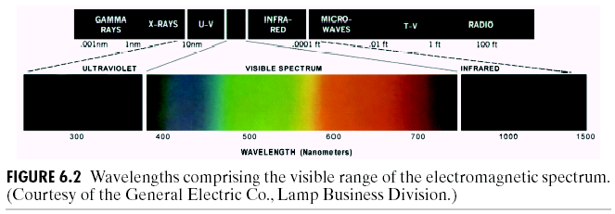
When viewed in full color (Fig. 6.2), no color in the spectrum ends abruptly, but rather each color blends smoothly into the next.
Three basic qualities describing the quality of a chromatic light source:
(1) Radiance: the total amount of energy flowing from the light source (in watts, W).
(2) Luminance: a measure of the amount of energy an observer perceives from a light source (in lumens, lm).
(3) Brightness: a subjective descriptor that is practically impossible to measure.

Slide 4
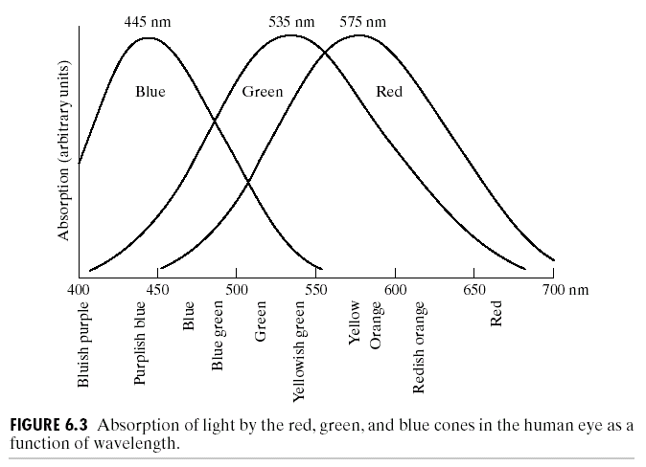
Fig. 6.3 shows average experimental curves detailing the absorption of light by the red, green, and blue cones in the eye.

Slide 5
The primary colors of light: R (red), G (green), and B (blue). The secondary colors of light: magenta (R+B), cyan (G+B), and yellow (R+G).
The primary colors of pigments: magenta, cyan, and yellow.
The secondary colors of pigments: R, G, B.
Fig. 6.4 shows the primary and secondary colors of light and pigment.
The characteristics distinguishing one color from another are brightness, hue, and saturation.
Hue and saturation together are called chromaticity, i.e., a color may be characterized by its brightness and chromaticity.

Slide 6
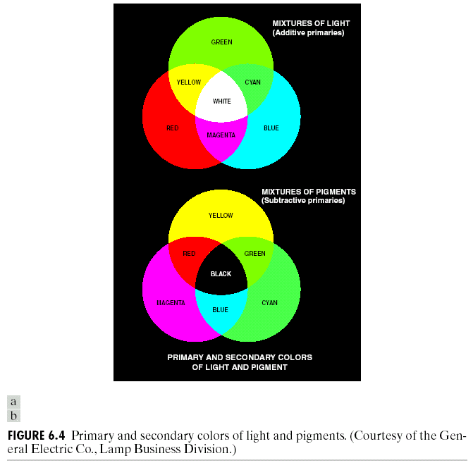

Slide 7
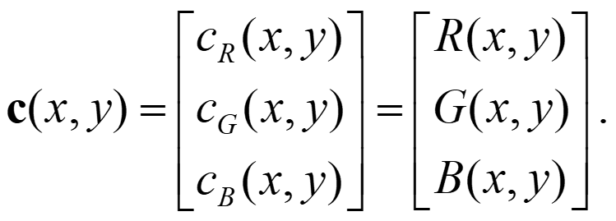
The amounts of R, G, and B forming any particular color are called the tristimulus values, denoted by X, Y, and Z, respectively.
A color can be specified by its trichromatic coefficients, defined as:
(6.1-1)
(6.1-2)
(6.1-3)
where
(6.1-4)

Slide 8
Another approach for specifying colors is to use the CIE chromaticity diagram shown in Fig. 6.5.
For any value of x and y, the corresponding value of z (blue) is 1-(x+y).
The point of equal energy in Fig. 6.5 corresponds to equal fractions of the three primary colors (CLE white light).
Any point located on the boundary of the chromaticity chart is fully saturated, whereas the saturation at the point of equal energy is zero (more white light ➔ less saturation).
Color mixing in the chromaticity diagram: a point on a line segment joining any two color points.
A triangle with vertices at any three fixed colors cannot enclose the entire color region in Fig. 6.5.

Slide 9
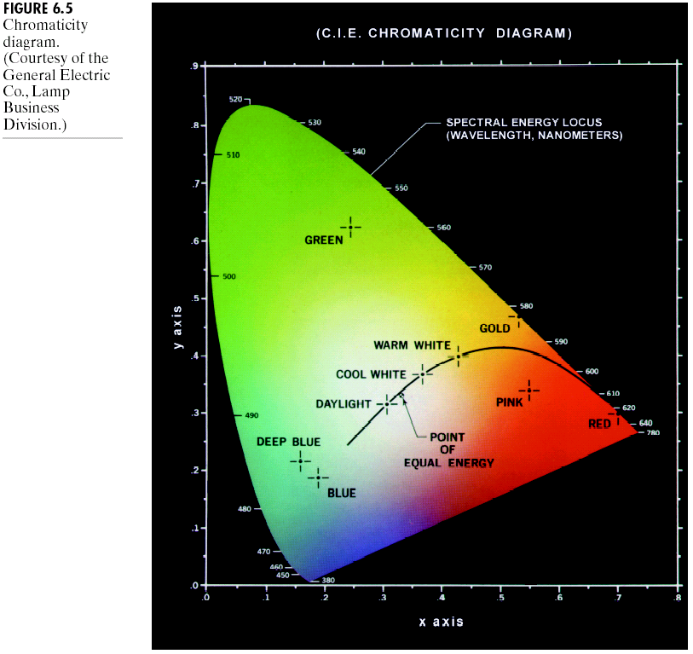

Slide 10
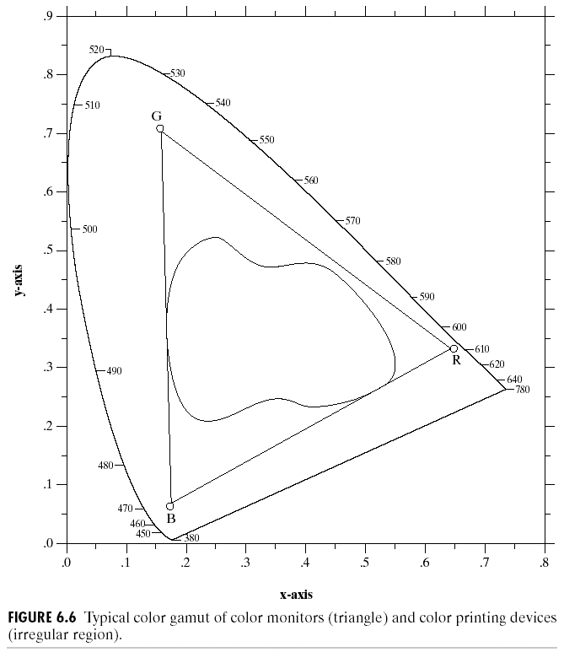
The triangle in Fig. 6.6 shows a typical range of colors (the color gamut) produced by RGB monitors.

Slide 11
Color Models
A color model is a specification of a coordinate system and a subspace within that system where each color is represented by a single point.
Important models
(1) The RGB model for color monitors and color video cameras.
(2) The CMY (cyan, magenta, yellow) and CMYK (CMY + black) models for color printing.
(3) The HSI (hue, saturation, intensity) or HSV model for humans’ description and interpretation of color.

Slide 12
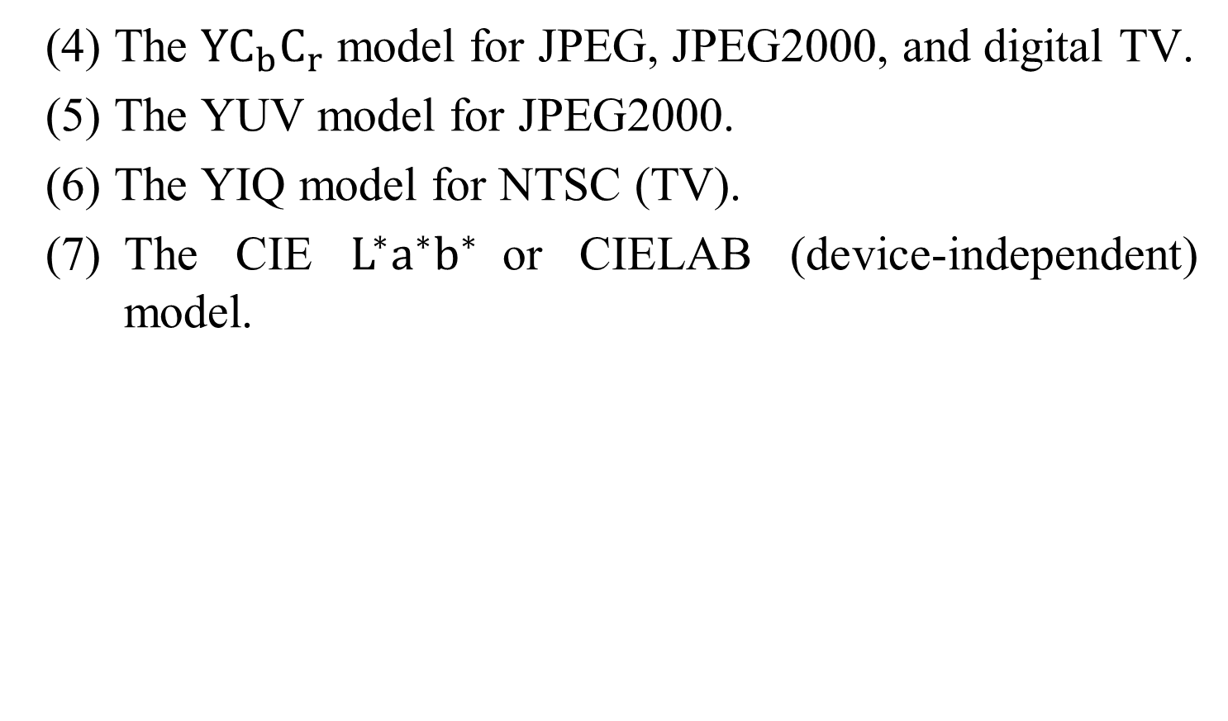
Color Models
(4) The $YC_{b}C_{r}$ model for JPEG, JPEG2000, and digital TV.
(5) The YUV model for JPEG2000.
(6) The YIQ model for NTSC (TV).
(7) The CIE $L^{∗}a^{∗}b^{∗}$or CIELAB (device-independent) model.

Slide 13
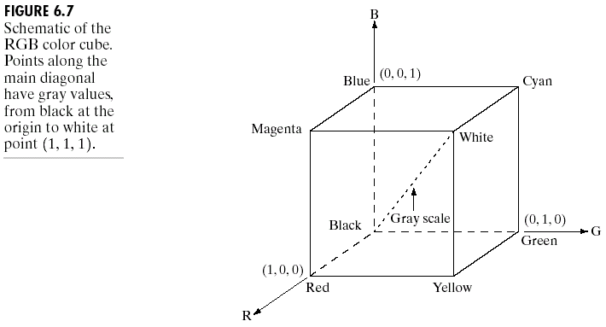
Fig. 6.7 shows the cube of the color subspace of interest.

Slide 14
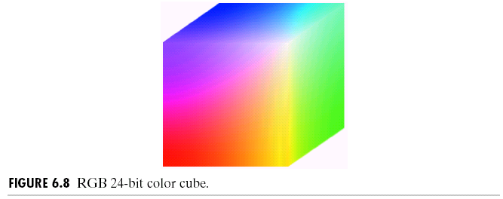
The full-color image is usually denoting a 24-bit RGB color image with (2⁸)³ = 16777216 distinct colors.
Fig. 6.8 shows the 24-bit RGB color cube corresponding to the diagram in Fig. 6.7.
Fig. 6.9(a) shows that an image of the cross-sectional plane is viewed by feeding the three individual component images into a color monitor and Fig. 6.9(b) shows the three hidden surface planes of the cube in Fig. 6.8.

Slide 15
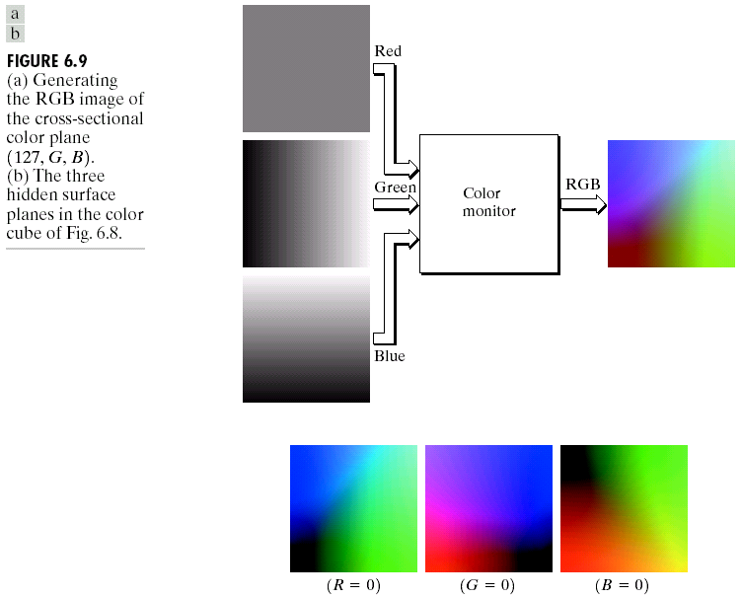

Slide 16
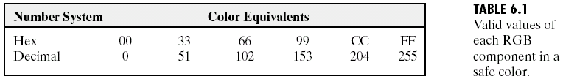
Many existing systems are limited to 256 colors. This subset of colors is called the set of safe RGB colors, the set of all-systems-safe colors, safe Web colors or safe browser colors.
256 colors = 216 common-used colors + 40 specialized colors.
Table 6.1 shows the values of each RGB component in a safe color.
Fig. 6.10 shows the 216 safe RGB colors and Fig. 6.11 shows the RGB safe color cube.

Slide 17
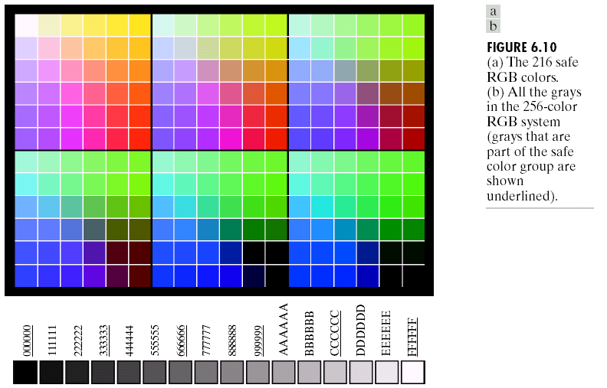
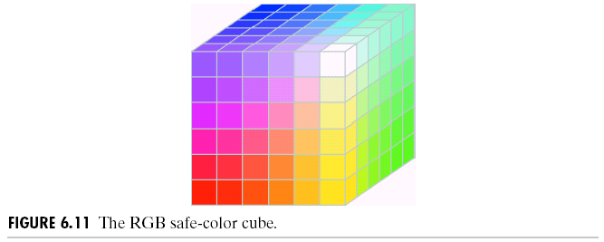

Slide 18
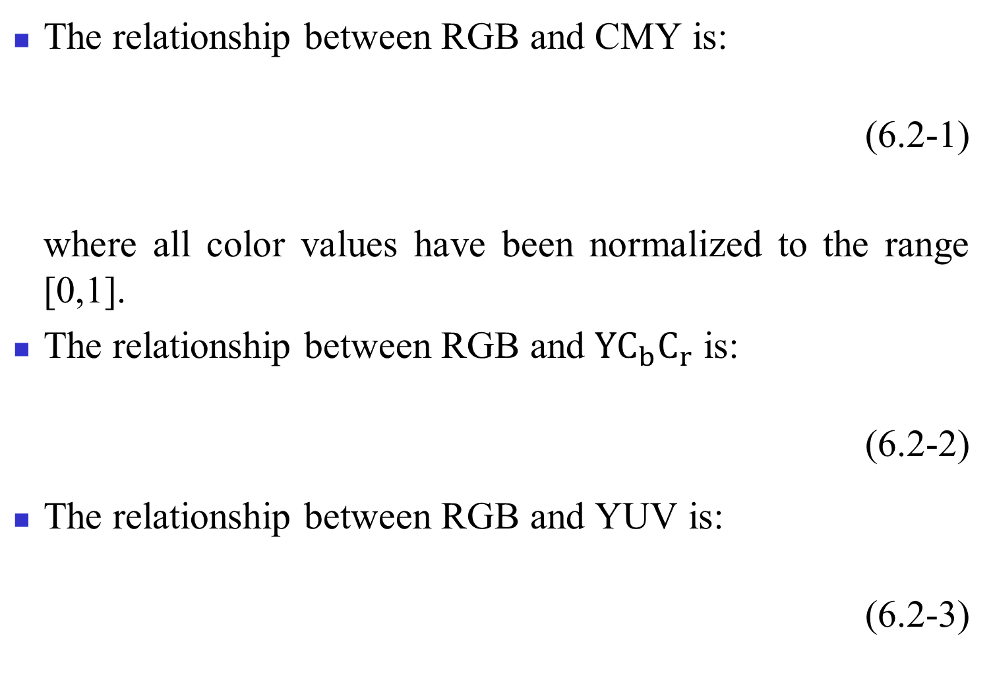
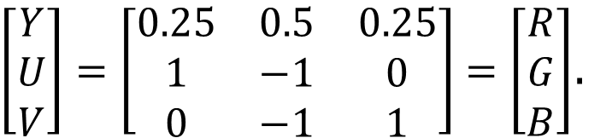
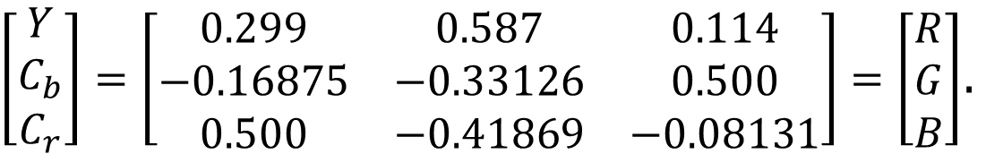
The relationship between RGB and CMY is:
(6.2-1)
where all color values have been normalized to the range [0,1].
The relationship between RGB and $YC_{b}C_{r}$ is:
(6.2-2)
The relationship between RGB and YUV is:
(6.2-3)
$\left[\begin{matrix}Y \\ C_{b} \\ C_{r}\end{matrix}\right]=\left[\begin{matrix}0.299 & 0.587 & 0.114 \\ −0.16875 & −0.33126 & 0.500 \\ 0.500 & −0.41869 & −0.08131\end{matrix}\right]=\left[\begin{matrix}R \\ G \\ B\end{matrix}\right]$.
$\left[\begin{matrix}Y \\ U \\ V\end{matrix}\right]=\left[\begin{matrix}0.25 & 0.5 & 0.25 \\ 1 & −1 & 0 \\ 0 & −1 & 1\end{matrix}\right]=\left[\begin{matrix}R \\ G \\ B\end{matrix}\right]$.

Slide 19
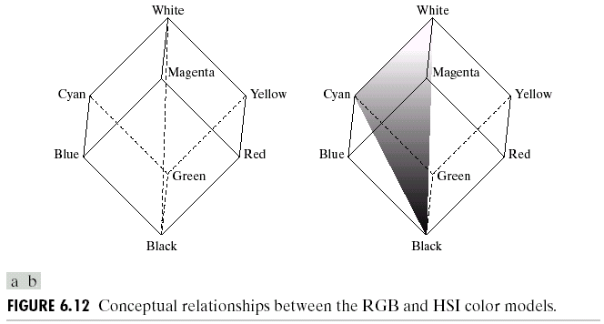
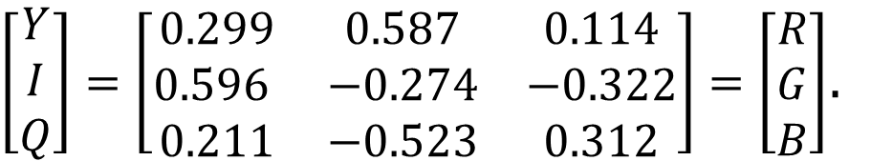
The relationship between RGB and YIQ is:
(6.2-4)
The HSI color model decouples the intensity component from the color-carrying
information (H and S)
in a color image.
$\left[\begin{matrix}Y \\ I \\ Q\end{matrix}\right]=\left[\begin{matrix}0.299 & 0.587 & 0.114 \\ 0.596 & −0.274 & −0.322 \\ 0.211 & −0.523 & 0.312\end{matrix}\right]=\left[\begin{matrix}R \\ G \\ B\end{matrix}\right]$.
Fig. 6.12 shows the conceptual relationships between the RGB and HSI color models.

Slide 20
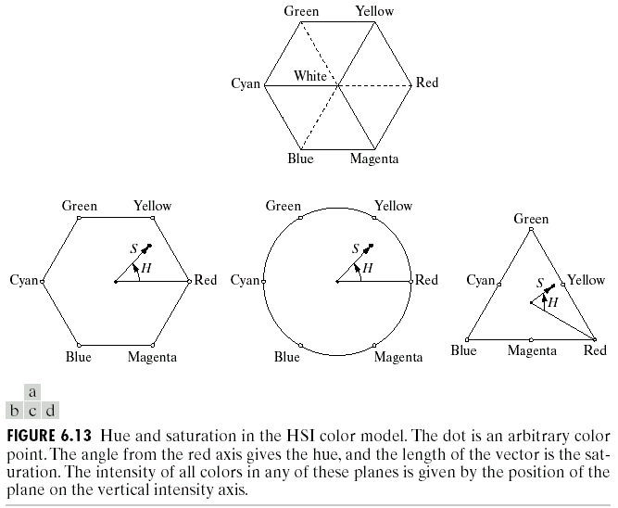
Fig. 6.13 shows the hue and saturation in the HSI color model.

Slide 21
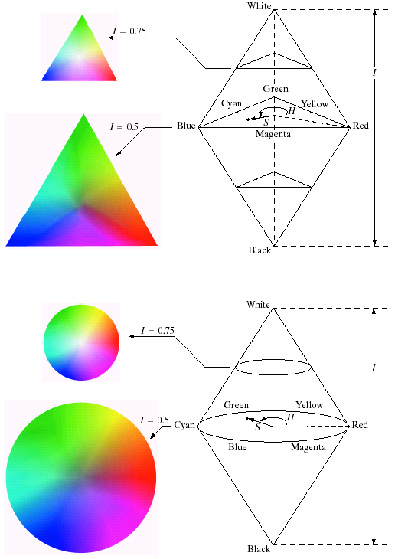
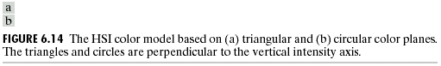
Fig. 6.14 shows the HSI model based on triangular and circular color planes.

Slide 22
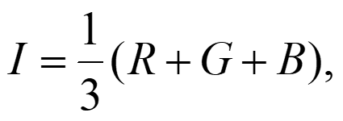
Converting colors from RGB to HSI
Given an image in RGB color format, the HSI components can be obtained by:
(6.2-5)
(6.2-6)
(6.2-7)
where the RGB values have been normalized to the range [0,1].

Slide 23
Converting colors from HSI to RGB
Given HSI values in the interval [0,1], we begin by multiplying H by 360° so that the hue values will be returned to its original range of [0°, 360°].
RG sector (0° ≤ H ＜ 120°):
(6.2-8)
(6.2-9)
(6.2-10)

Slide 24
GB sector (120° ≤ H < 240°):
(6.2-11)
Then the RGB components are:
(6.2-12)
(6.2-13)
(6.2-14)
BR sector (240° ≤ H ≤ 360° ):
(6.2-15)
Then the RGB components are:
(6.2-16)
(6.2-17)
(6.2-18)

Slide 25
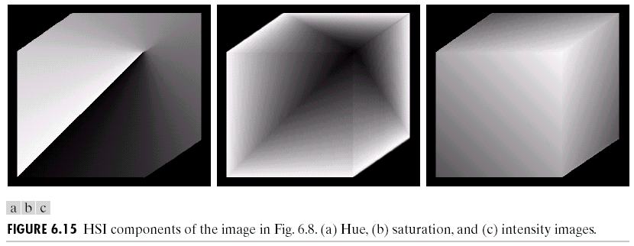
Fig. 6.15 shows the hue, saturation, and intensity images for the RGB values shown in Fig. 6.8.
Fig. 6.16 shows an RGB color image and the components of its corresponding HSI image.

Slide 26
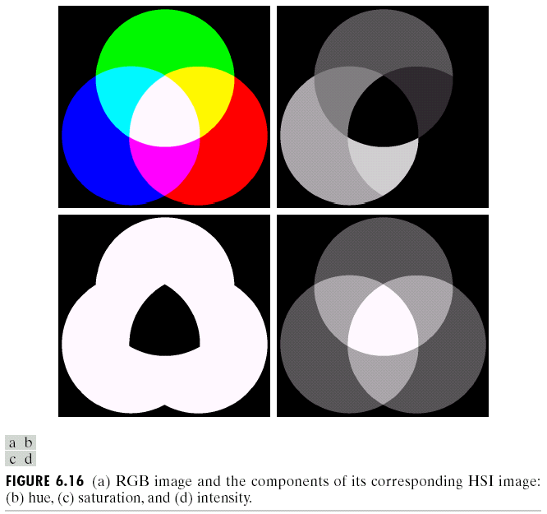

Slide 27
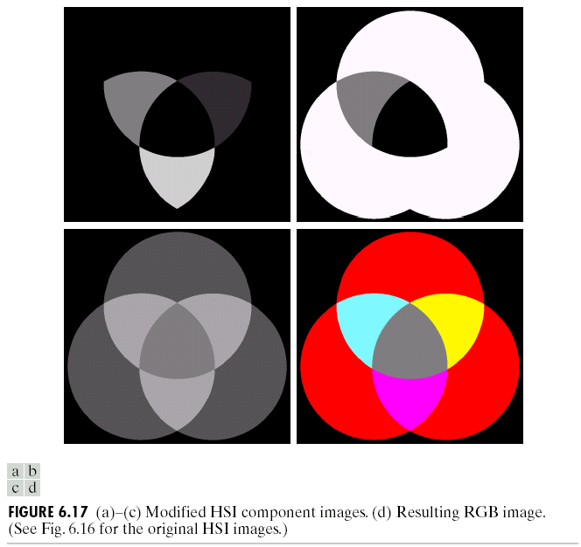
Fig. 6.17 shows the modified HSI component images and the corresponding resulting RGB image.

Slide 28
Pseudocolor Image Processing
Pseudocolor (false color) image processing consists of assigning colors to gray values based on a specified criterion.
The principal use of pseudocolor is for human visualization and interpretation of gray-scale events in an image or image sequences.

Slide 29
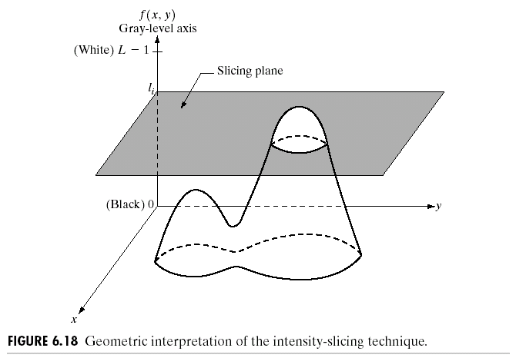
Intensity slicing
If an image is interpreted as a 3-D function (x, y, f (x, y)), the method can be viewed as one of placing planes parallel to the coordinate plane of the image; each plane slices the function in the area of intersection.
Fig. 6.18 shows an example of using a plane at f (x, y)=l_{i} to slice the image function into two levels.

Slide 30
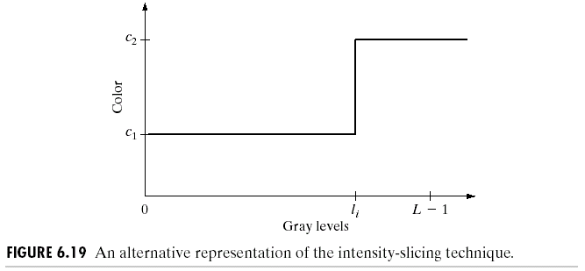
Fig. 6.19 shows an alternative representation of the mapping in Fig. 6.18.

Slide 31
Let [0, L-1] represent the gray scale, let level l₀ represent black [f (x, y)=0], and level l_{L-1} represent white [f (x, y)=L-1]. Suppose that P planes perpendicular to the intensity axis are defined at levels l₁, l₂, …, l_{P}. Then, assuming that 0 < P < L-1, the P planes partition the gray scale into P+1 intervals, V₁, V₂, …, V_{P+1}. Gray-level to color assignments are:
(6.3-1)
where c_{k} is the color associated with the kth intensity interval V_{k} defined by the partitioning planes at l = k - 1 and l = k.

Slide 32
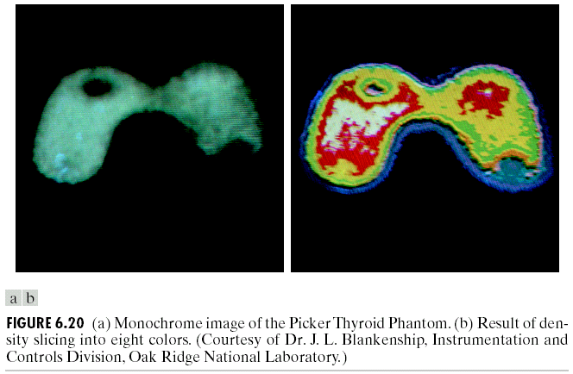
Fig. 6.20 shows a simple practical use of intensity slicing (8 distinct colors).

Slide 33
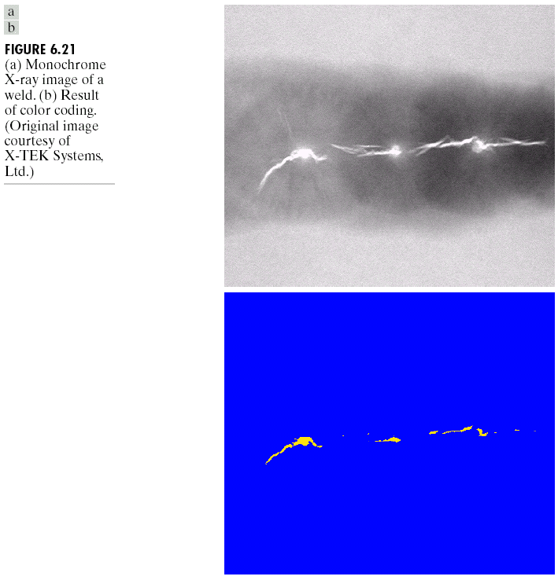
Fig. 6.21(a) shows a monochrome X-ray image of a weld and Fig. 6.21(b) shows the corresponding result of color coding.

Slide 34
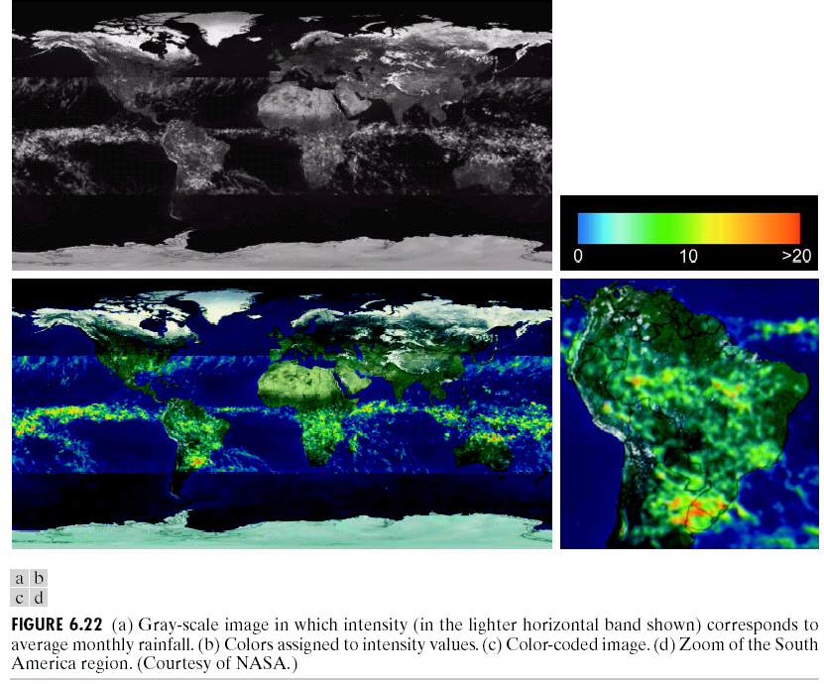
Fig. 6.22(a) shows the intensity image corresponds to average monthly rainfall, and Fig. 6.22(b)~(d) shows the results of assigning colors to intensity values.

Slide 35
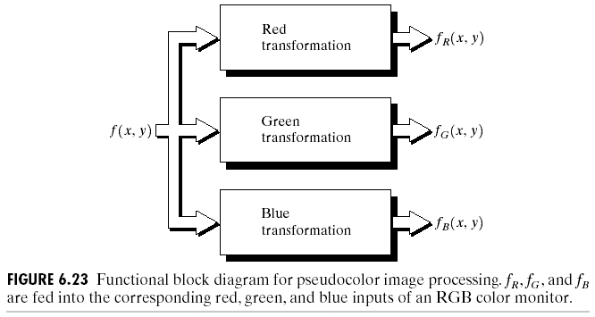
Gray level to color transformations
The idea of the system shown in Fig. 6.23 is to perform three independent transformations on the gray level of any input pixel.
➔ The three results are then fed separately into the red, green, and blue channels of a color monitor.

Slide 36
Fig. 6.24 shows two monochrome images of luggage obtained from an airport X-ray scanning system, in which the left image contain ordinary articles and the right image contains the same articles as well as a block of plastic explosives.
Fig. 6.25 shows the transformation functions used in Fig. 6.24, in which the gray-level bands corresponding to the explosive, garment bag, and background, respectively.
Fig. 6.24(b) is obtained by the transformation functions in Fig. 6.25(a).
Fig. 6.24(c) is obtained by the transformation functions in Fig. 6.25(b).

Slide 37
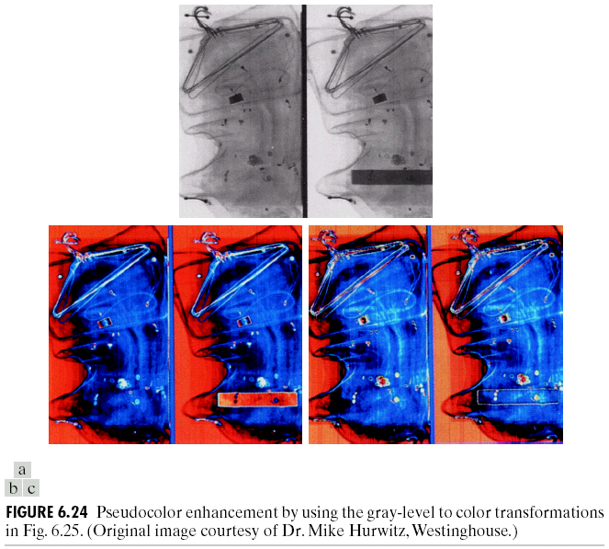

Slide 38
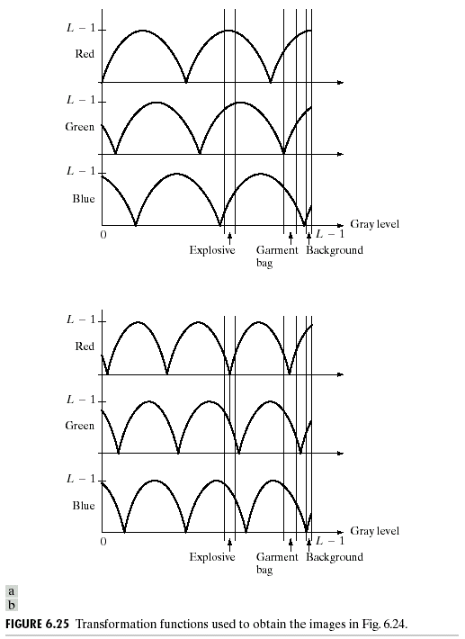

Slide 39
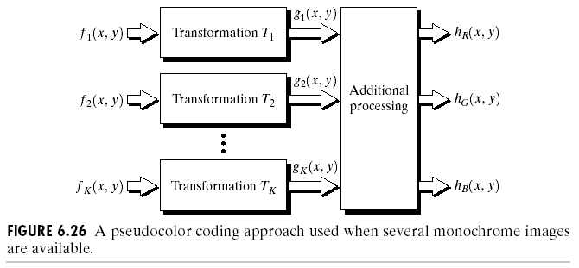
Fig. 6.26 shows a system combining several monochrome images into a single color composite.
This type of approach is frequently used in multispectral image processing.
Fig. 6.27(a)~(d) shows 4 images in bands 1~4 in Fig. 1.10, Fig. 6.27(e) shows the color composite image with (a)~(c) as the R, G, B components, and Fig. 6.27(f) shows the color composite image with (d), (b), (c) as the R, G, B components, respectively.

Slide 40
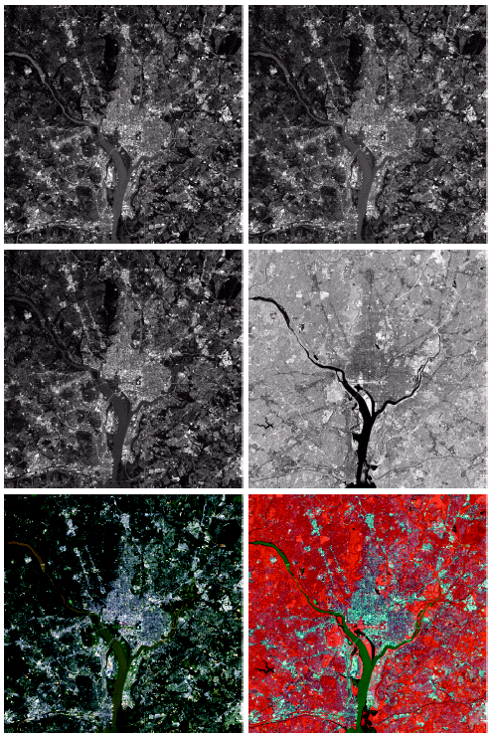
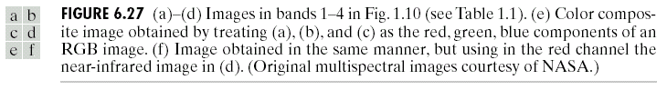

Slide 41
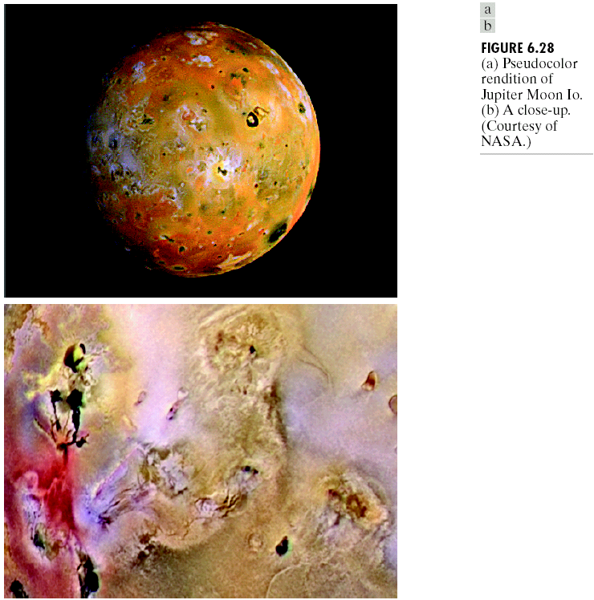
Fig. 6.28 shows the pseudocolor rendition of Jupiter Moon Io.

Slide 42
Full-Color Image Processing
Two categories
(1) We process each component image individually and then form a composite processed color image.
(2) We work with color pixels directly.
Let c represent an arbitrary vector in RGB color space:
(6.4-1)
(6.4-2)
For an image of size M × N, there are MN such vectors, c(x, y), for x = 0, 1, 2, …, M-1; y = 0, 1, 2, …, N-1.

Slide 43
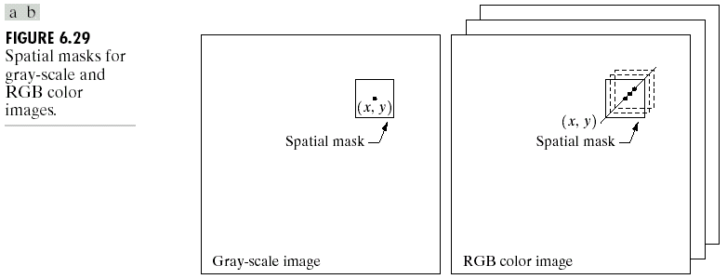
Fig. 6.29 shows the spatial masks for gray-scale and RGB color images.

Slide 44
Color Transformations
Color transformations deal with processing the components of a color image within the context of a single color model.
The color transformation:
(6.5-1)
where f(x, y) is a color input image, g(x, y) is the transformed or processed color output image, and T is an operator on f over a spatial neighborhood of (x, y).
The color transformations of the form:
s_{i} = T_{i}(r₁, r₂, …, r_{n}), i = 1, 2, …, n, (6.5-2)
where r_{i} and s_{i} are variables denoting the color components of f(x, y) and g(x, y) at any point (x, y), n is the number of color components, and {T₁, T₂, …, T_{n}} is a set of color transformation functions that operate on r_{i} to produce s_{i}.

Slide 45
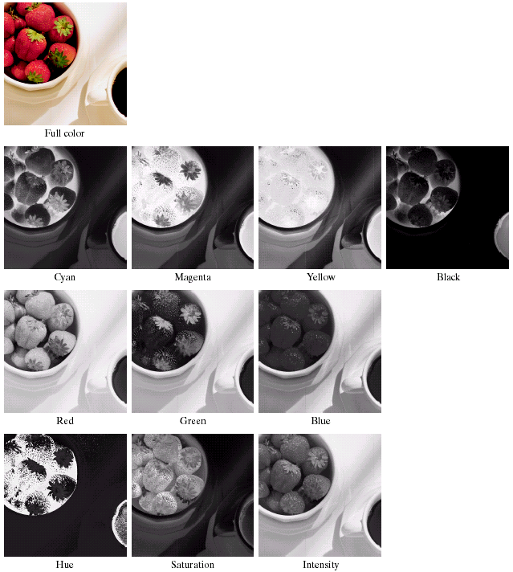
Fig. 6.30 shows a high-resolution color image of a bowl of strawberries and cop of coffee and its various color-space components.

Slide 46
Suppose that we wish to modify the intensity of the image in Fig. 6.30(a) using:
(6.5-3)
where 0 < k < 1. In the HSI color space, this can be done by:
s₃ = kr₃, (6.5-4)
where s₁ = r₁ and s₂ = r₂. In the RGB color space, three components must be transformed:
(6.5-5)
The CMY space requires a similar set of linear transformations:
(6.5-6)

Slide 47
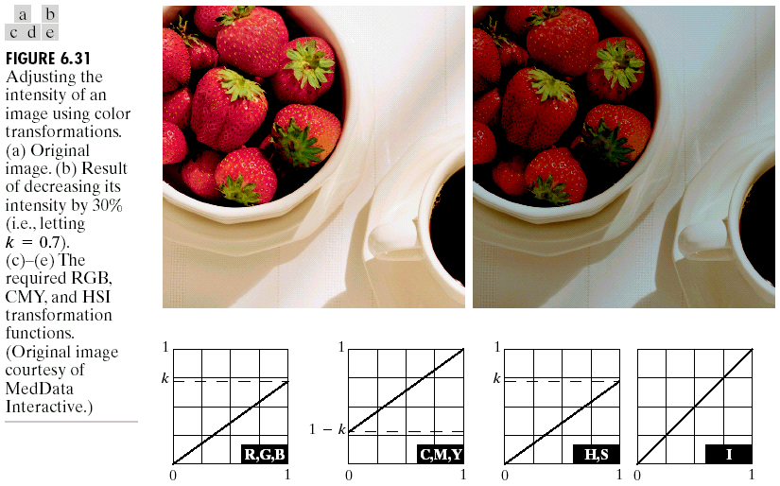
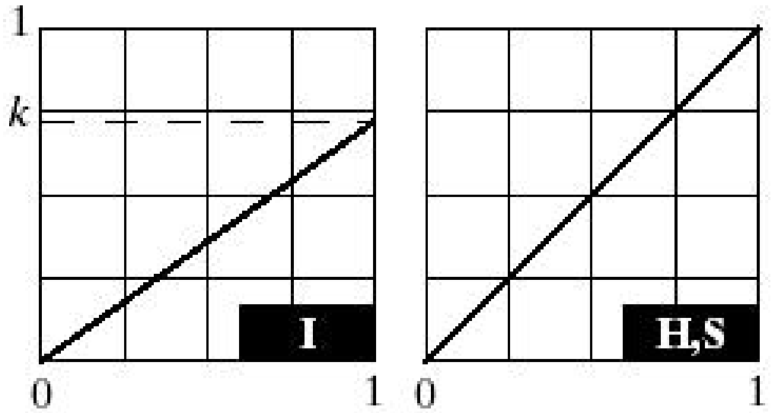
Fig. 6.31(b) shows the results of applying any of the transformations in Eqs. (6.5-4)~(6.5-6) to the image in Fig. 6.31(a) using k = 0.7.

Slide 48
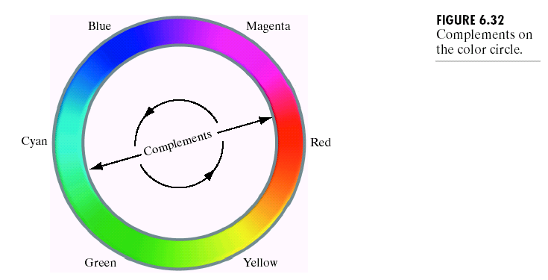
Color complements
The hues directly opposite one another on the color circle of Fig. 6.32 are called color complements.

Slide 49
Fig. 6.33(a) and (c) shows the image from Fig. 6.30(a) and its color complement.
The RGB transformations and its HSI approximation transformation used to compute the complement are plotted in Fig. 6.33(b).
Fig. 6.33(d) shows the color complement using the HSI approximation transformation.

Slide 50
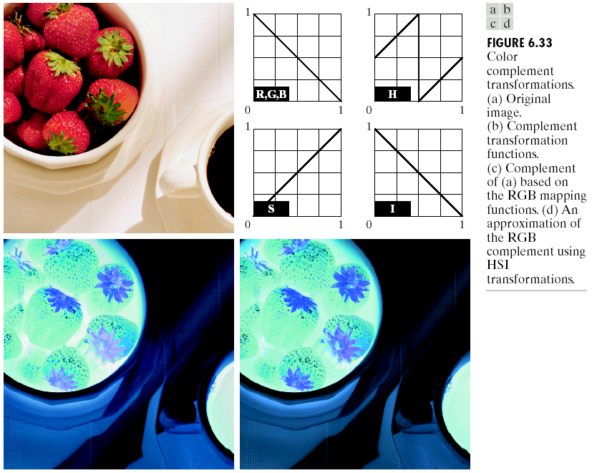

Slide 51
Color slicing
Highlighting a specific range of colors in an image is useful for separation objects from their surroundings.
Two possible methods:
(1) display the colors of interest so that they stand out from the background,
(2) use the region defined by the colors as a mask for further processing.

Slide 52
One simple way to “slice” a color image is to map the colors outside some range of interest to a nonprominent neutral color.
If the colors of interest are enclosed by a cube (or hypercube for n > 3) of width W and centered at a prototypical (e.g., average) color with components (a₁, a₂, …, a_{n}), the necessary set of transformation is :
(6.5-7)
If a sphere is used to specify the colors of interest, Eq. (6.5-7) becomes:
(6.5-8)
where R₀ is the radius of the enclosing sphere (or hypersphere for n > 3) and (a₁, a₂, …, a_{n}) are the components of its center.

Slide 53
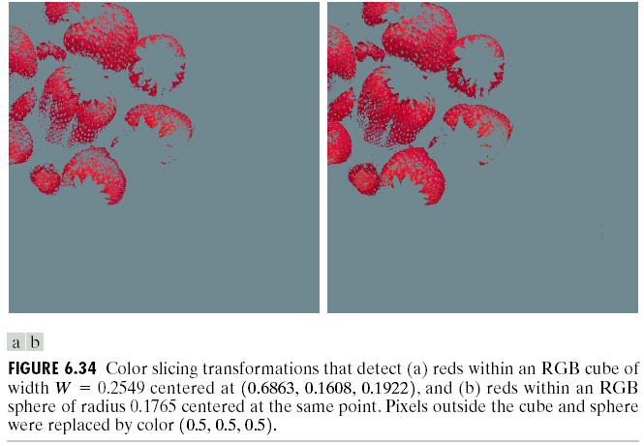
Fig. 6.34(a) and (b) shows the results of applying both transformations (Eqs. (6.5-7) and (6.5-8)), where W=0.2549 and R₀=0.1765.

Slide 54
Tone and color corrections
The colors of the monitor should represent accurately any digitally scanned source images, as well as the final printed output.
A device-independent color model relating the color gamuts of the monitors and output devices (as well as other devices) to one another.
A function of the quality of the color profiles mapping each device to the model and the model itself.
The model of choice for many color management systems (CMS) is the CIE L*a*b* model, also called CIELAB.

Slide 55
The L*a*b* color components are:
(6.5-9)
(6.5-10)
(6.5-11)
where
(6.5-12)
and X_{W}, Y_{W}, and Z_{W} are reference white tristimulus values-typically the white of a perfectly reflecting diffuser under CIE standard D65 illumination (defined by x = 0.3127 and y = 0.3290 in the CIE chromaticity diagram of Fig. 6.5).

Slide 56
The L*a*b* color space is colorimetric (i.e., colors perceived as matching are encoded identically), perceptually uniform (i.e., color differences among various hues are perceived uniformly, and device independent.
The L*a*b* system is an excellent decoupler of intensity (L*) and color (a* = R-G, b* = G-B).
The tonal range of an image (its key type) refers to its general distribution of color intensities.
Fig. 6.35 shows typical transformations used for correcting three common tonal imbalances-flat, light, and dark images.
The S-shaped transformation in the flat case is ideal for boosting contrast (Fig. 3.2(a)).
The transformations in the light and dark cases are reminiscent of the power-low transformations (Fig. 3.6).
Because the RGB components are adjusted equally, the hues of the images are not changed in Fig. 6.35.

Slide 57
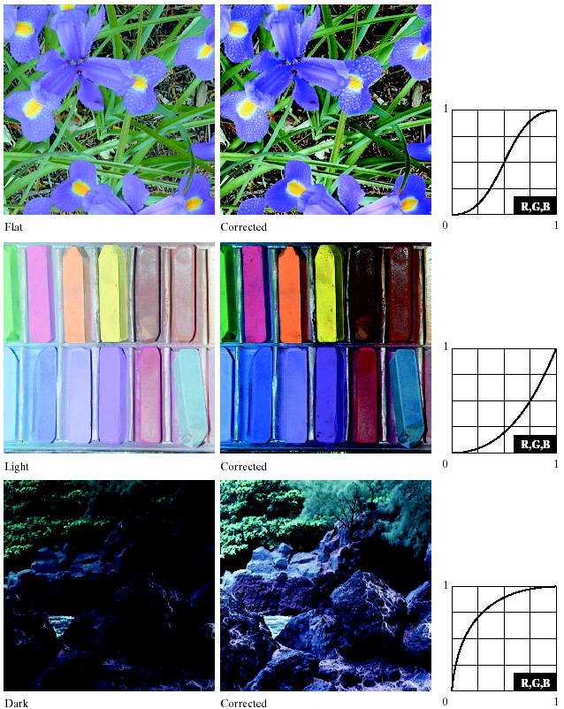
55

Slide 58
Color balancing corrections
The perception of one color is affected by its surrounding colors. The color wheel in Fig. 6.32 can be used to predict how one color component will affect others.
The proportion of any color can be increased by decreasing the amount of the opposite (or complementary) color in the image.
Similarly, it can be increased by raising the proportion of two adjacent colors or decreasing the percentage of the two colors adjacent to the complement.
Fig. 6.36 shows the transformations used to correct simple CMYK output imbalances.

Slide 59
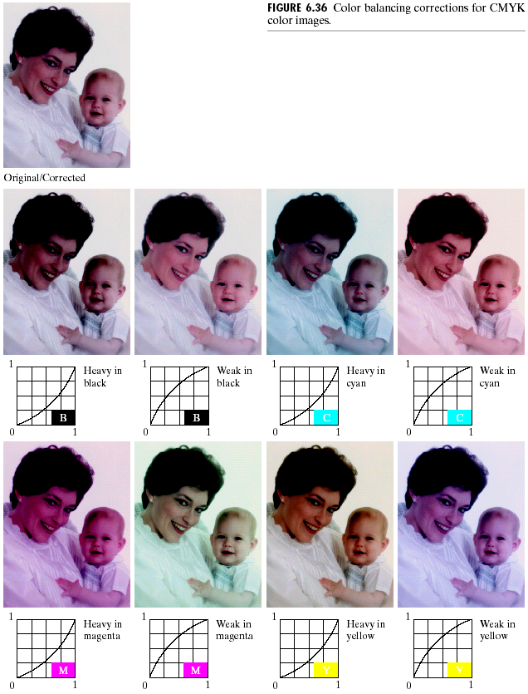

Slide 60
Histogram processing
It is unwise to histogram equalize the components of a color image independently ➔ result in erroneous colors!!
A logical approach is to spread the color intensities uniformly, leaving the colors themselves (e.g., hues) unchanged.
Fig. 6.37 shows an example of histogram equalization in the HSI color space, in which the hue component is unchanged.

Slide 61
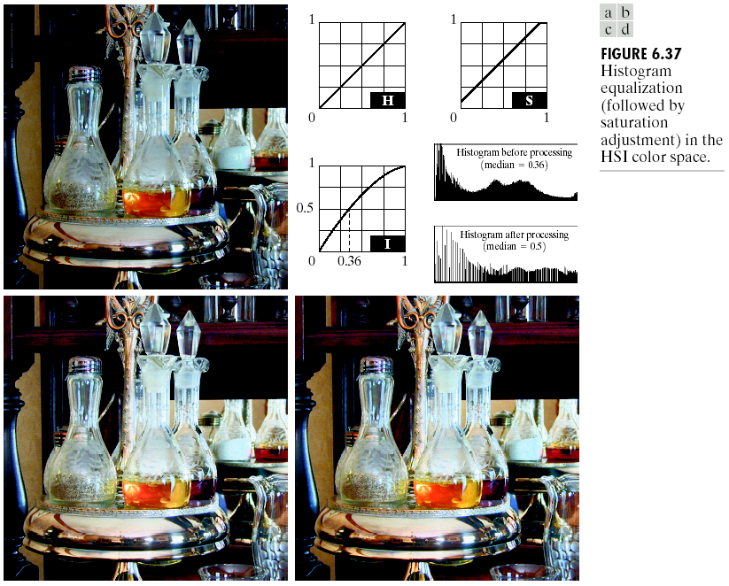

Slide 62
Color image smoothing
Let S_{xy} denote the set of coordinates defining a neighborhood centered at (x, y) in an RGB color image. The average of the RGB component vectors in this neighborhood is:
(6.6-1)
It follows from Eq. (6.4-2) and the properties of vector addition that:
(6.6-2)

Slide 63
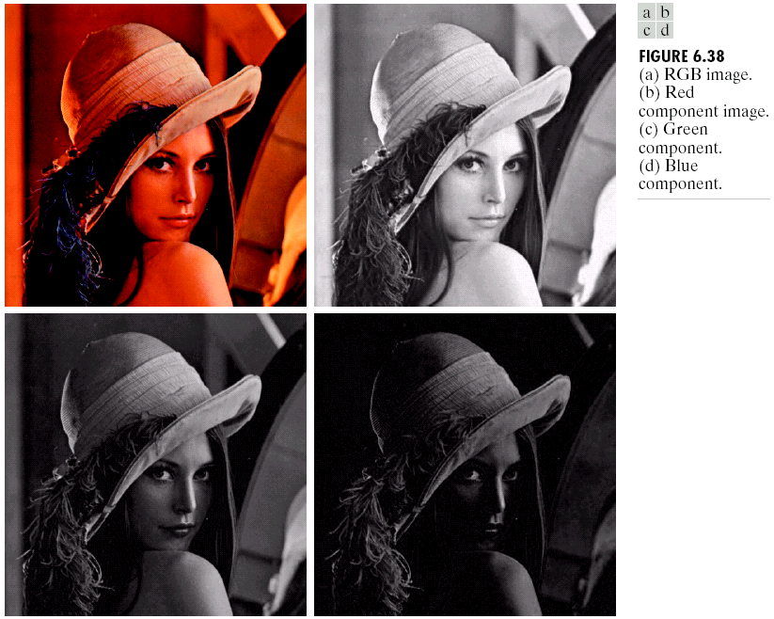
Fig. 6.38 shows the original image (a) and its RGB components (b)~(d).

Slide 64
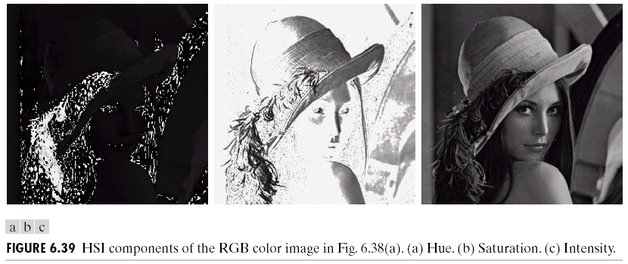
Fig. 6.39 shows the HSI components of the RGB image in Fig. 6.39(a).
It is more efficient to smooth only the intensity (I) component of the HSI representation in Fig. 6.39.

Slide 65

Fig. 6.40 shows the results between (1) smoothing each RGB component image and (2) smoothing the intensity (I) component of the HSI image (converting back to RGB), where a 5×5 average mask is employed.

Slide 66

Color image sharpening
In the RGB color system, the Laplacian of vector c in Eq. (6.4-2) is:
(6.6-3)
Fig. 6.41 compares the results between (1) Laplacian sharpening processing each RGB component and (2) Laplacian sharpening processing the intensity (I) component and converting back to RGB.

Slide 67
Color segmentation in HSI space
Suppose that we want to segment the reddish region in the lower left of the image in Fig. 6.42(a), where Fig. 6.42(b)~(d) are its HSI component images.
Comparing Fig. 6.42(a) and (b), the interesting region has relatively high hue (H) value.
Fig 6.42(e) shows a binary mask generated by thresholding the saturation (S) image with a threshold equal to 10% of the maximum value in the S image.
Fig. 6.42(f) is the product of the mask with the H image and Fig. 6.42(g) is the histogram of the product image (Fig. 6.42(f )) (range 0~1).
Fig. 6.42(h) shows the result of thresholding the product image with threshold = 0.9 (range 0~1).

Slide 68



Slide 69
Segmentation in RGB vector space
The objective of segmentation is to classify each RGB pixel in a given image as having a color in the specified range or not.
Let a denote the average RGB color vector and z an arbitrary point in RGB space. Then z is similar to a if the distance between z and a is less than a specified threshold D₀.
The Euclidean distance between z and a is:
(6.7-1)

Slide 70

The locus of points such that D(z, a) ≤ D₀ is a solid sphere of radius D₀, as shown in Fig. 6.43(a).
A useful generalized distance measure is:
(6.7-2)
where C is the covariance matrix of the samples representative of the color we wish to segment. The locus of points such that D(z, a) ≤ D₀ describes a solid 3-D elliptical body [Fig. 6.43(b)] with the important property that its principal axes are oriented in the direction of maximum data spread.
A compromise is to use a bounding box shown in Fig. 6.43(c).

Slide 71

The rectangular region shown in Fig. 6.44(a) contains samples of reddish colors to be segmented out from the color image.
A box was centered at a, and its dimensions along each of the RGB axes are selected as 1.25 , i.e., from (a_{R}-1.25 ) to (a_{R}+1.25 ).
Fig. 6.44(b) shows the result of segment in RGB vector space.

Slide 72

Color edge detection
Fig. 6.45(a)~(c) and Fig. 6.45(e)~(f) show the RGB component images of the color images shown in Fig. 6.45(d) and (h), respectively.
➔ Processing the three individual planes to form a composite gradient image may yield erroneous results.

Slide 73
Let r, g and b be unit vectors along the R, G, B axis of RGB color space, and define the vectors:
(6.7-3)
(6.7-4)
Let the quantities g_{xx}, g_{yy}, and g_{xy} be defined as follows:
(6.7-5)
(6.7-6)
(6.7-7)

Slide 74
It can be shown (Di Zenzo [1986]) that the direction of maximum rate of change of c(x, y) is given by the angle:
(6.7-8)
and that the value of the rate of change at (x, y), in the direction of θ, is given by:
(6.7-9)
Note that F(θ) = F(θ+π). Usually, F(θ) needs to be computed only for values of θ in the half-open interval [0, π ).

Slide 75


Slide 76

Fig. 6.46(b) is the gradient of the image in Fig. 6.46(a), using the vector method in this section.
Fig. 6.46(c) shows the image obtained by computing the gradient of each RGB component image and forming a composite gradient image by “adding.” Fig. 6.46(d) shows the difference between Fig. 6.46(b) and (c).
Fig. 6.47 shows the RGB gradient images of the color image in Fig. 6.46.

Slide 77
Noise in Color Images
Note that the CCD red component of an RGB image would tend to be noisier than the other two (G,B) component images.
Fig. 6.48(a)~(d) shows the three planes of an RGB image corrupted by Gaussian noise and the composite RGB image, respectively.

Slide 78


Slide 79

Fig. 6.49(a)~(c) shows the HSI component images of the noisy color image in Fig. 6.48(d).
Fig. 6.50(b)~(d) shows the HSI component images of the noisy RGB image with G plane corrupted by salt-and-pepper noise in Fig. 6.50(a).

Slide 80


Slide 81

Color Image Compression
Fig. 6.51(a) shows an original RGB image and Fig. 6.51(b) shows the result of compressing and decompressing the image in (a).

